Slide 1
BT201
Biochemical Process Calculations
Tutorial
01/11/2022

Slide 2
Problem 1:
1000 kilograms per hour of steam drives a turbine. The steam enters the turbine at 50 atm
and 500 ⁰C at a linear velocity of 70 m/s and leaves the turbine at atmospheric pressure and a velocity of 400 m/s. The turbine delivers shaft work at a rate of 50 kW, and the heat loss from the turbine is estimated to be 15000 kcal/h. Calculate the enthalpy change associated with the process.

Slide 3
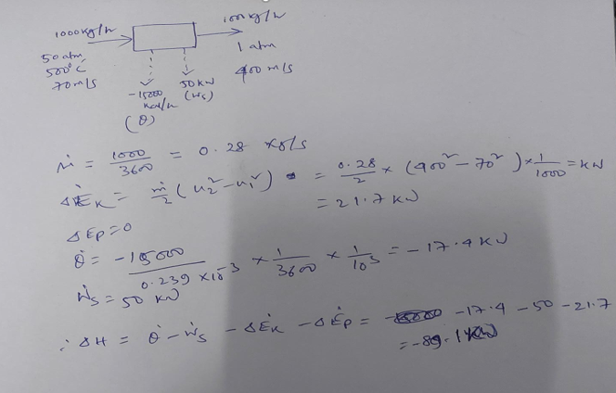

Slide 4

Problem 2:

Slide 5
